Slide 1
Draft GNA Regulations- CTU Observations/Proposal

Slide 2
Key Observations
Definition of Associated Transmission System (ATS)
Connectivity Bank Guarantees
Treatment of Connectivity Bank Guarantee
Alignment of Existing LTA Agreements with new GNA Regulations
Other inputs

Slide 3
1. Definition of Associated Transmission System (ATS):
The Draft GNA regulation defines ATS as
‘6.2. Any augmentation required, excluding terminal bay(s), to the existing ISTS identified under Regulation 6.1 of these regulations, shall be considered as the Associated Transmission System (ATS) for the Applicant(s).’
Technical Difficulty to segregate planned ISTS as ATS and Common System :
ICTs as immediate connectivity system :
ICTs at a particular pooling station are shared by all the generation projects connected there
Capacity of ICTs do not match with that of individual generation project.
High capacity transmission system planned from Generation switchyard
Generation granted with a particular ATS may be operationalized with part or existing system.
There could be “big ATS” and “Nil or negligible ATS” for generation projects seeking connection at same location.

Slide 4
1. Definition of Associated Transmission System (ATS):
Proposal:
ATS:
Generation End Pooling Station/Bay
Dedicated Transmission Line (DTL)
terminating bay at ISTS Station
Network Expansion/System Strengthening : All ISTS Augmentation
Network Expansion /System Strengthening
ATS = DTL+ Bays at Gen and ISTS End

Slide 5
2. Connectivity Bank Guarantees:
For Connectivity with Existing ISTS System:
Conn-BG1 amounting to Rs. 50 lakhs,
Conn-BG2 towards terminal bay(s)
Conn-BG3 @ Rs. 2 lakh/MW, for the existing ISTS
For Connectivity where Network Expansion is required:
Conn-BG1 amounting to Rs. 50 lakhs
Conn-BG2 equal to estimated cost of ATS and terminal bay(s)
Proposal:
As terminal bays of the dedicated line is proposed under the scope of Applicant, it is proposed to have Single Bank Guarantee for all the cases (with or without ISTS Network Expansion).

Slide 6
3.Treatment of Connectivity Bank Guarantee
The Generators once connected are considered deemed GNA Grantee without any transmission charge liability and as such, there is a remote chance of Generator running away after getting connected. Therefore, the Bank Guarantees may not be kept hold for five years.
Proposal:
Upon the completion of complete connectivity the Conn BG shall be returned within a period of 02 months thereafter.
In case of any delay in Commercial operation from its earlier stated SCOD/revised SCOD as approved by Competent Authority, the connectivity grantee shall be liable to pay a fixed amount /week or part thereof subject to the Upper Cap of Conn-BG amount.

Slide 7
4. Alignment of Existing LTA Agreements with new GNA Regulations
Both Transmission and Connection Agreement as per the present regulation may not be required.
In place of Transmission Agreement, the acceptance letter for final grant of Connectivity may be considered.
In place of Connection Agreement, the acceptance letter from the Grantee against the Connection Offer Letter of CTU may be considered.
Accordingly, revised intimation/ Connection Offer Letter and acceptances thereof shall be individual self-contained documents for all regulatory, commercial and legal purposes.

Slide 8
5. Other inputs:
Provision for Charges in case of Surrender
The word “relinquishment” may be supplemented with “surrender”.
Further, the levy of charges in case of such “surrender” may be classified as “transmission charges equivalent” of a fixed period e.g. 60 months in line with CERC Order dated 08.03.2019 in Petition No. 92/MP/2015 (Para 99 @pg. 124 of 177).
Overlapping with TGNA
T-GNA can be applied for any period from 1 (one) time block and up to 11 (eleven) months.
Accordingly, the application for use of GNA by the other entity may be submitted to Nodal Agency at least thirteen months before the start date of the use of GNA.

Slide 9
5. Other inputs:
“Connectivity” may be replaced with “Connectivity for GNA”
Under existing Connectivity Regulations, Connectivity does not guarantee evacuation of firm power. However, under subject GNA regulations, Connectivity enables transfer of power.
Distribution licensee / Bulk consumer to apply together for GNA and Connectivity
A distribution licensee or a Bulk consumer, seeking GNA under Clause 17.1(iii) proposed to seek Connectivity under Cl 4.1, provided that the entity has to apply for connectivity and GNA together.

Slide 10
5. Other inputs:
GNA both for Injection and Drawal
If the States needs both drawal and injection GNA, they may define both the quantum separately, as the ISTS requirement for injection and drawal of power may be different.
Relinquishment of GNA within and outside the region
If the STU seek decrease in the GNA within the region and increase in GNA outside the region or vice versa, keeping the total GNA Requirement same, the decrease in GNA shall require relinquishment charges.

Slide 11
Thank You

Slide 12
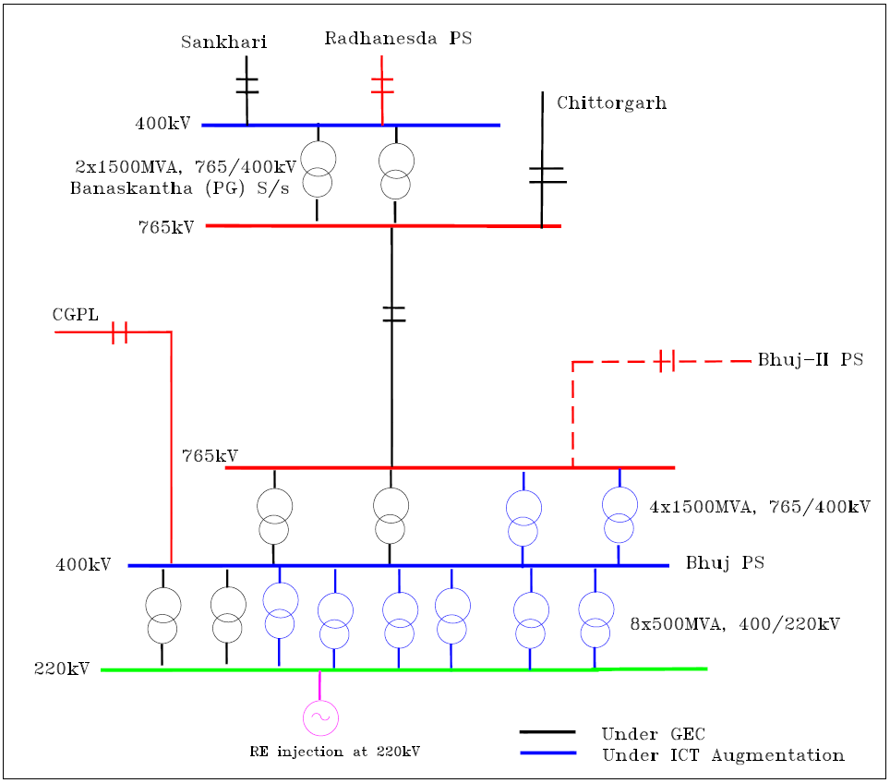
Bhuj Pooling Station
Generation Project | ATS / Common tr. System
1. LTA granted : 2924.5MW Green Infra (550), TPL (500), Alfanar (300), Renew (AP2) (300), Renew (TN) (265), Avikiran (285) AWEK1L (725MW) | 6x500MVA, 400/220kV ICT 2x1500MVA, 765/400kV ICT Estimated Cost: INR 496Cr Common Tr. System for AWEK1L (725) (Estimated Cost: INR 2721 Cr)
2. LTA relinquished: 1314.5MW TPL (500), Renew (265), AWEK1L (550)
3. LTA Granted : 1032.5MW AWEK3L(250),CTN(140),Netra(300),AWEK5L(130MW), Renew (AP2) (37.5), Srijan (175) | Common Transmission System
4. LTA Operationalization: 849MW Renew (AP2) (150), Green Infra (398.8, balance 151.2 with existing system); AWEK1L (100), Alfanar (200) | 2x500MVA ICTs (1st & 2nd)
5. LTA Operationalized: 212.5MW Renew (AP2) (112.5), Alfanar (100) | 1x500MVA ICTs (3rd)
6. LTA Operationalized: 360MW Avikiran (285), AWEK1L (75) | 3x500MVA ICTs (4th, 5th, 6th) 2x1500MVA, 765/400kV ICT
7. LTA Operationalized: 337.5MW AWEK3L (250), CTN (50), Renew (AP2) (37.5) | Existing transmission system

Slide 13
Neemuch Pooling Station (1GW)
Project: Neemuch Solar Park (500MW)
Associated Transmission System (ATS):
2x500MVA, 400/220kV Neemuch PS (new).
Neemuch PS – Chittorgarh (PG) 400kV D/c line (High Capacity)
Neemuch PS – Mandsaur 400kV D/c line (High Capacity)
Estimated Cost: INR 547 Cr
Transmission Scheme for Neemuch SP
Existing / UC

Slide 14
Narendra
Narendra
Narendra
Narendra
System
S/S
S/S
S/S
S/S
Aug. for
RE
Koppal PS
Koppal PS
Koppal PS
Koppal PS
G1
G
G
G1
7
G1
2
G
G1
G
3
2
G
G
3
2
1st RE Generator (50 MW)
ATS : PS + Koppal-N’dra line + Bays
Conn BG 1 : 0.5 Cr.
Conn BG 2 : 200 Cr.
Conn BG 3 : NA
Approx BG : 4 Cr / MW
2nd RE Generator (50 MW)
ATS : Bays
Conn BG 1 : 0.5 Cr.
Conn BG 2 : Bay Cost
Conn BG 3 : 1 Cr.(Existing System)
Approx BG : 2 lakh / MW
3rd RE Generator ( 500 MW)
ATS : ICT + Bays
Conn BG 1 : 0.5 Cr.
Conn BG 2 : 50 Cr.
Conn BG 3 : NA
Approx BG : 10 lakh / MW
7th RE Generator ( 200 MW)
ATS : System beyond Kopal + Bays
Conn BG 1 : 0.5 Cr.
Conn BG 2 : 2200 Cr.
Conn BG 3 : NA
Approx BG : 10 Cr / MW

